Slide 1
Learning new objects

Slide 2
Overview
You will complete 2 fMRI sessions, separated by 5–7 days.
Session 1: Approximately 90min
Session 2: Approximately 75min
You will perform several tasks while we measure your brain activity, including image viewing, watching a short video, and a main learning task.

Slide 3
Session 1 Outline
Structural Scan & Practice (5 min): A quick scan to map your brain and a chance to practice the task at your own pace.
Object Viewing (10 min): Viewing a fast sequence of images. Respond with a button press if you see the exact same image twice in a row.
Learning Task (40 min): The main portion of the study where you will learn object names.
Object Viewing (10 min): Viewing a fast sequence of images. Respond with a button press if you see the exact same image twice in a row.
Video (10 min): Relaxed viewing of a 10-minute video clip.

Slide 4
Object Viewing: Task Explanation
You will be show a fast sequence of images
Your task is to press any button when the same image is presented back-to-back
Don’t worry if you don’t react before the image dissappears. Still try and respond.

Slide 5

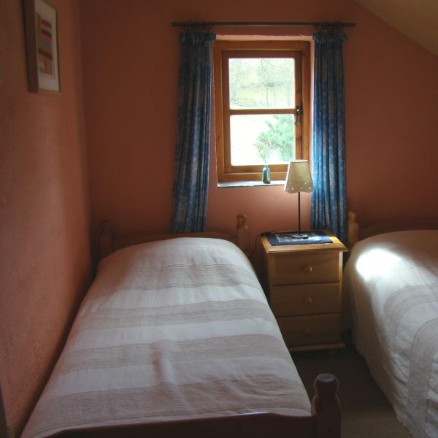


Object Viewing: Example (press next to start sequence)
Press now

Slide 6
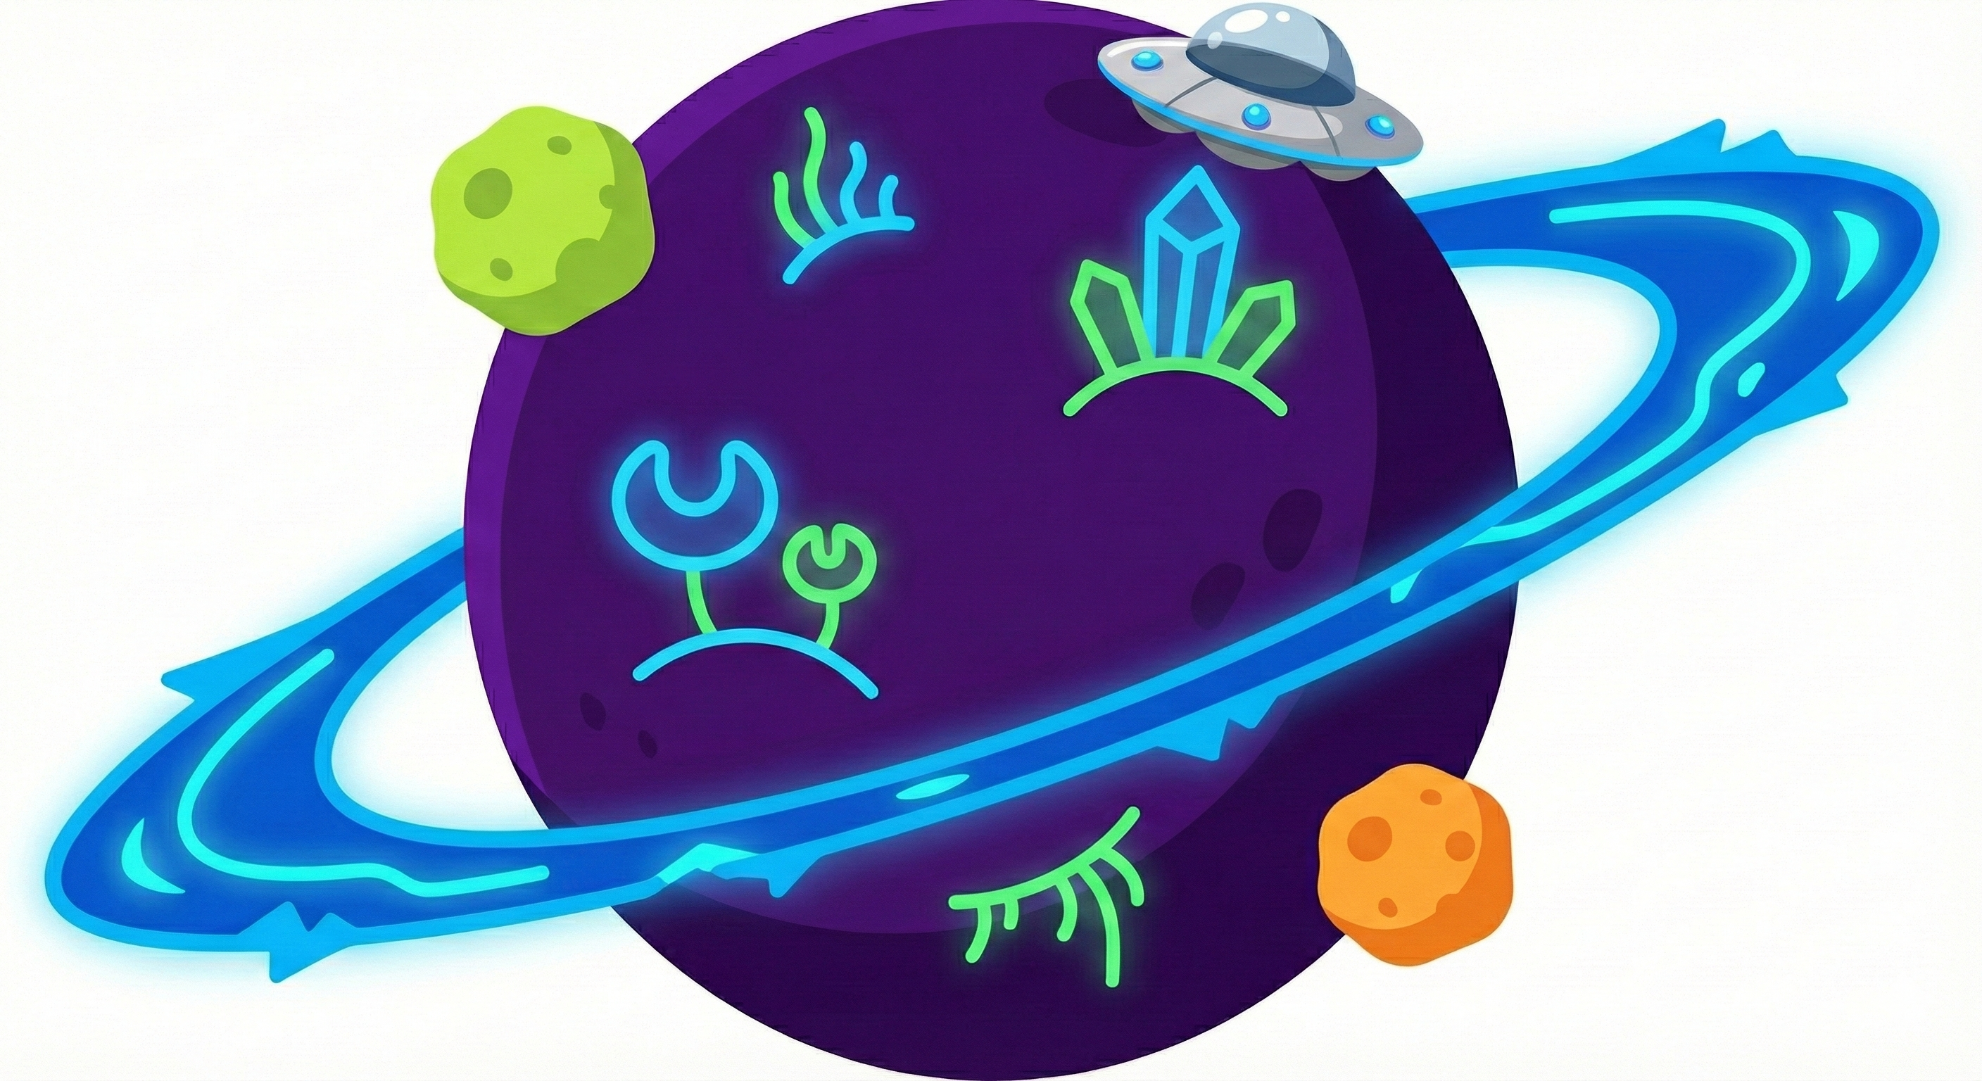
Learning Task: Identifying New Objects
You will be presented with images of objects one after the other.
Your goal is to learn the correct name for each object through trial and error.
These objects are from an alien planet: some objects will look more recognisable, while others can look more unfamiliar.

Slide 7
Learning Task: What to Expect
Consistency: The name of each object category stays the same across the entire experiment.
Variability: Just like objects in our world, no two images of the same object are exactly identical.
Objects with the same name will vary slightly in how they look.
Don't be surprised if the visual appearance changes slightly from trial to trial.

Slide 8
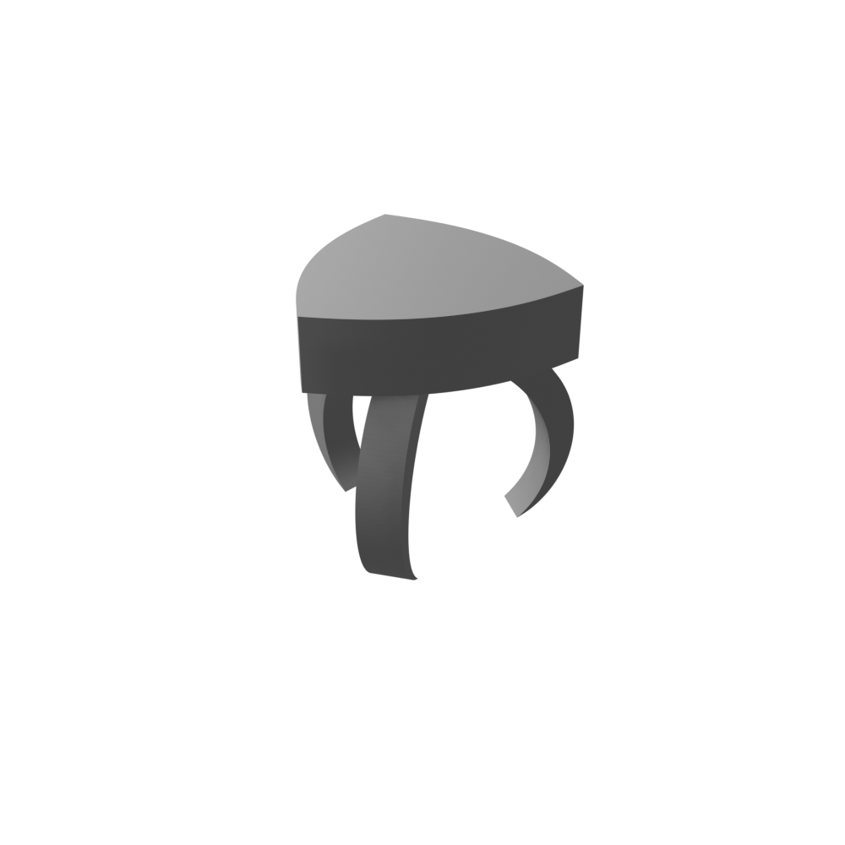
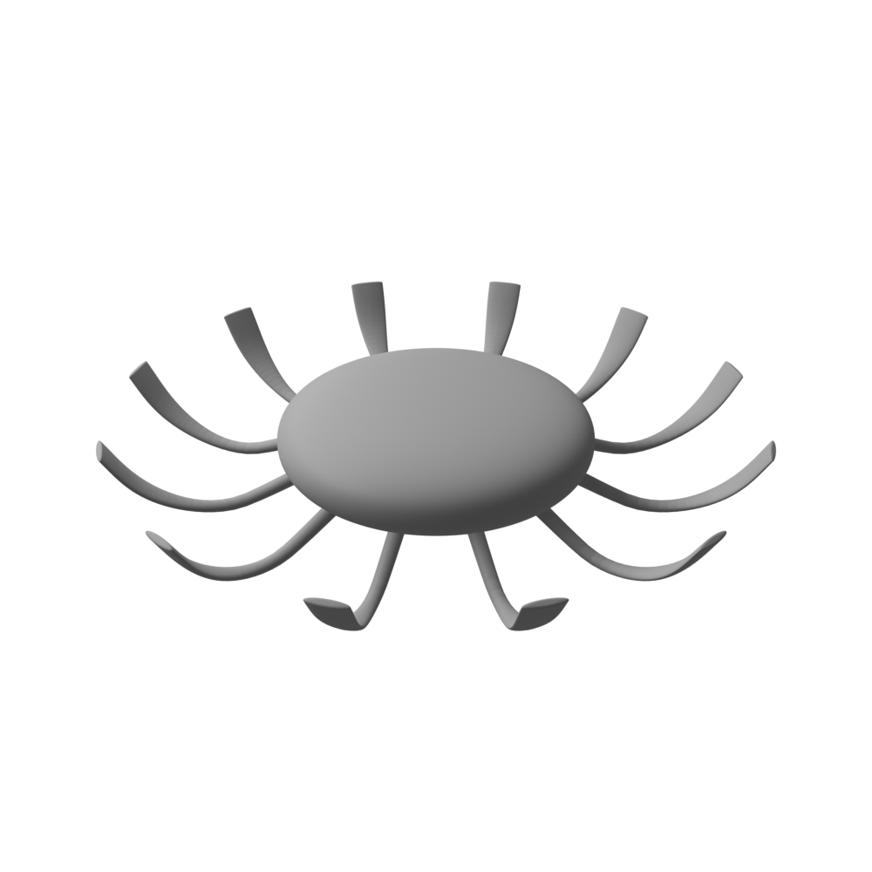

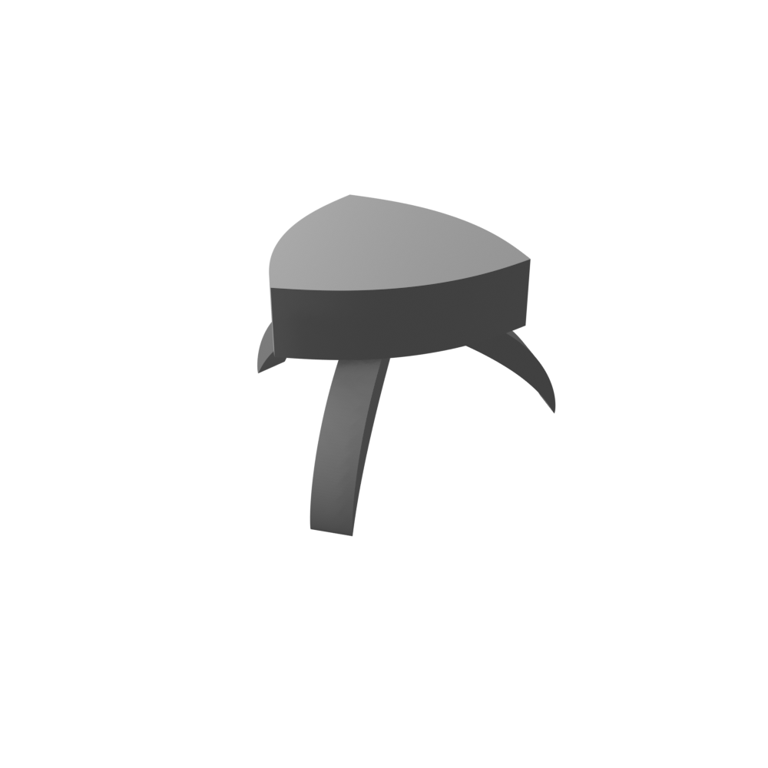
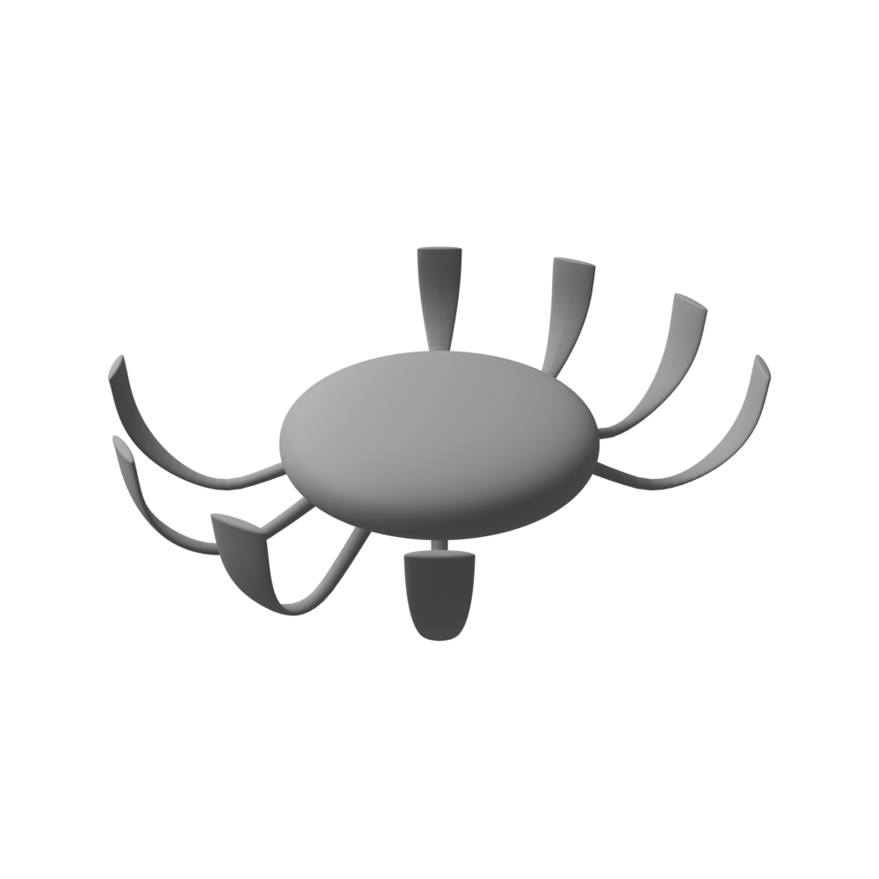

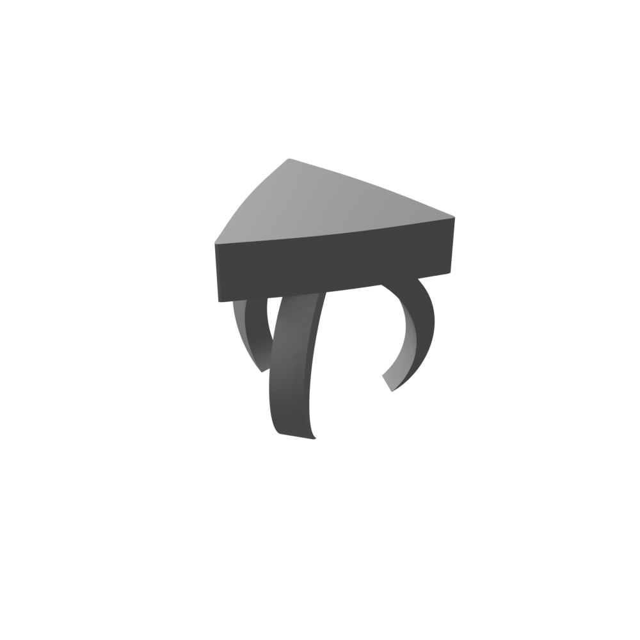
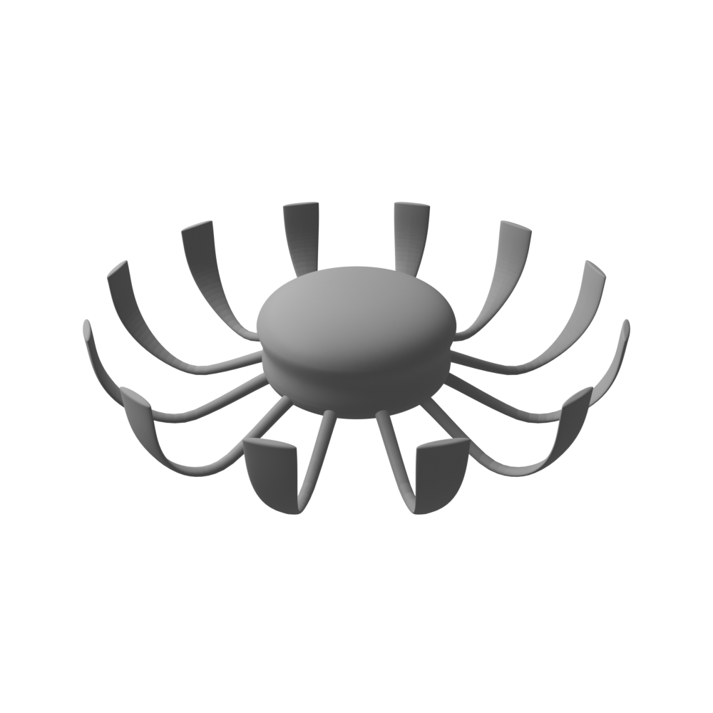

Alien object examples
Bottle
Seat
Hair clip
(As you can see, some objects look more familiar than others. There are slightly different looking versions of each object)

Slide 9
Alien objects you will be learning
You will be learning 9 different objects during the task:
Rubber eraser
Refrigerator
Sleeping bag
Vase
Radio
Teapot
Wallet
Hammer
Cup
(No need to memorise these now, you will learn them during the task!)

Slide 10
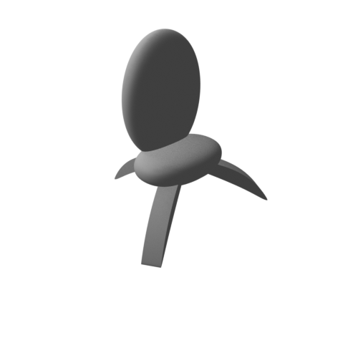
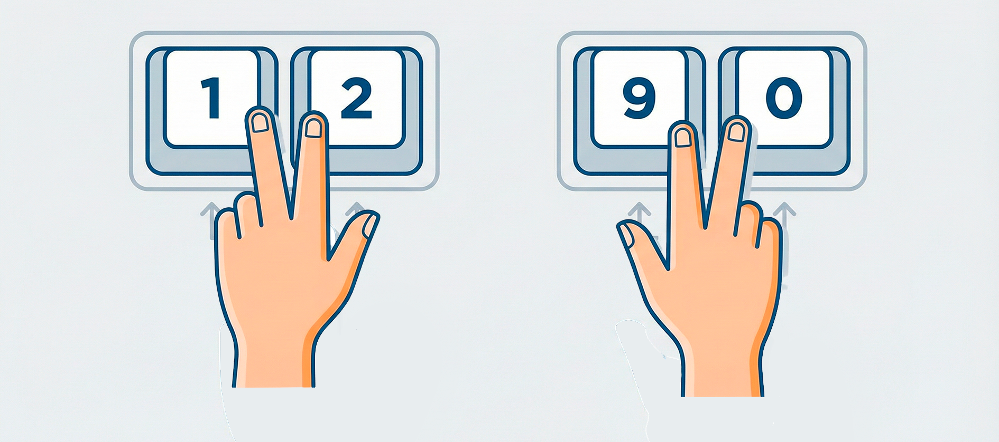
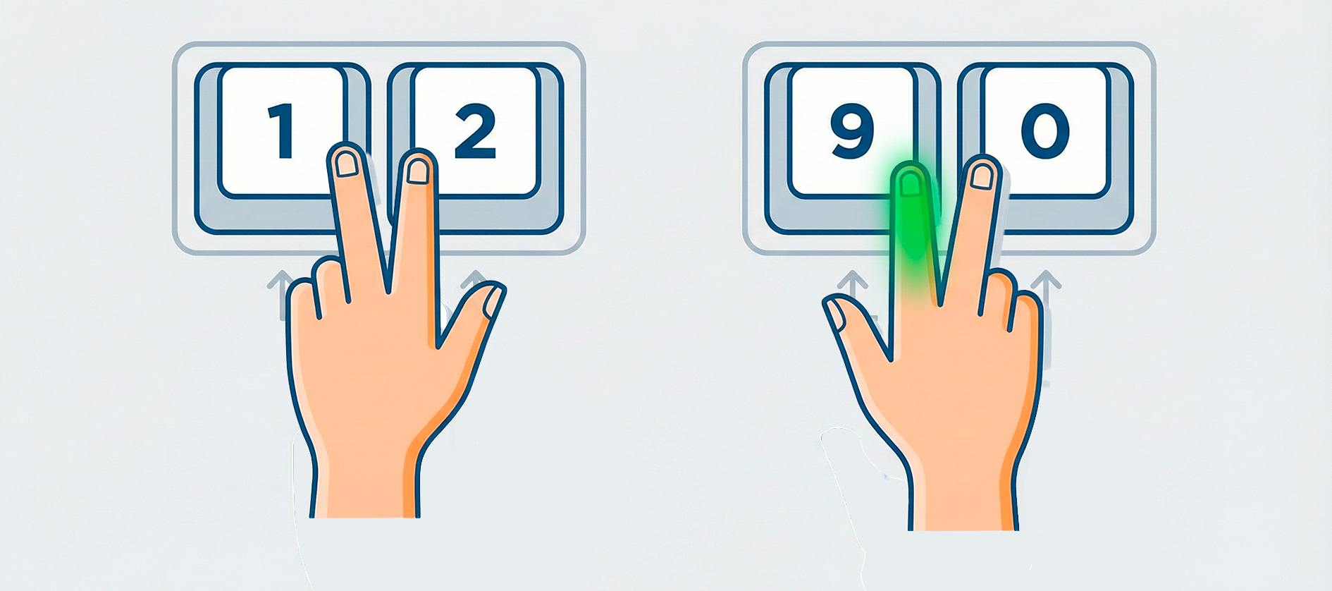
Step-by-Step Trial
Plate
Chair
Fork
Bike
Plate
Chair
Fork
Bike
Around 3s. Image only
2-3 s to respond
1s feedback
Ready
Respond!
Review feedback

Slide 11
Learning Task: Session 1 Details
The task is divided into 8 learning blocks.
Each block contains 27 trials and takes about 5 minutes.
You will have a short break between each block to rest your eyes.
After the 8 learning blocks, you will complete a final 5-minute test block.
These trials look identical to the learning task, but no feedback will be provided.

Slide 12
Returning for Session 2
When you return in 5–7 days, the procedure is almost identical but shorter.
You will complete 6 learning blocks instead of eight.
You will end with another test block without feedback.

Slide 13
Important Reminders
Speed & Accuracy: Try to be as fast and as accurate as possible.
Don't Skip: Try to provide an answer for every trial, even if you are guessing.
Time Limit: Remember, you only have a few seconds once the names appear.
Stay Focused: Use the feedback to refine your choices as you go.
Remember that no two object images will be completely identical, don’t get surprised by this.

Slide 14
Practical notes for the MRI scanner
Stay Still: The most important thing is to keep your head very still. Even small movements can make the brain images blurry and harder to analyze.
Noise: The scanner is quite loud, making a rhythmic thumping sound. This is normal and expected. You will be given headphones for protection.

Slide 15
Good luck!

